Slide 1
“Buddy” Poppy/National Home
2023-2024

Slide 2
“Buddy” Poppy
Utilized “Buddy” Poppy materials / resources on the National and Department website-Indicate which ones and how.
Drive. Indicate if held with or without post members and Numbers of Poppies distributed.
Promote “Buddy” Poppy thru Education in your community.

Slide 3
Participate in the Mid-Winter Conference
Make a Display using “Buddy” Poppy. Size No Larger than 16” Wide 16” Deep, by 20” High.

Slide 4
Why do we report?
Reporting is so important to you and your Auxiliary.
It shows the Department and National that you are committed to this program.

Slide 5
“Buddy” Poppy
When using “Buddy” Poppy as table decorations count every “Buddy” Poppy used. Please don’t say I used a “bunch”
You can report all “Buddy” Poppy you distribute.
The biggest thing is HAVE FUN!

Slide 6
V.F.W. National Home
Our new Logo

Slide 7
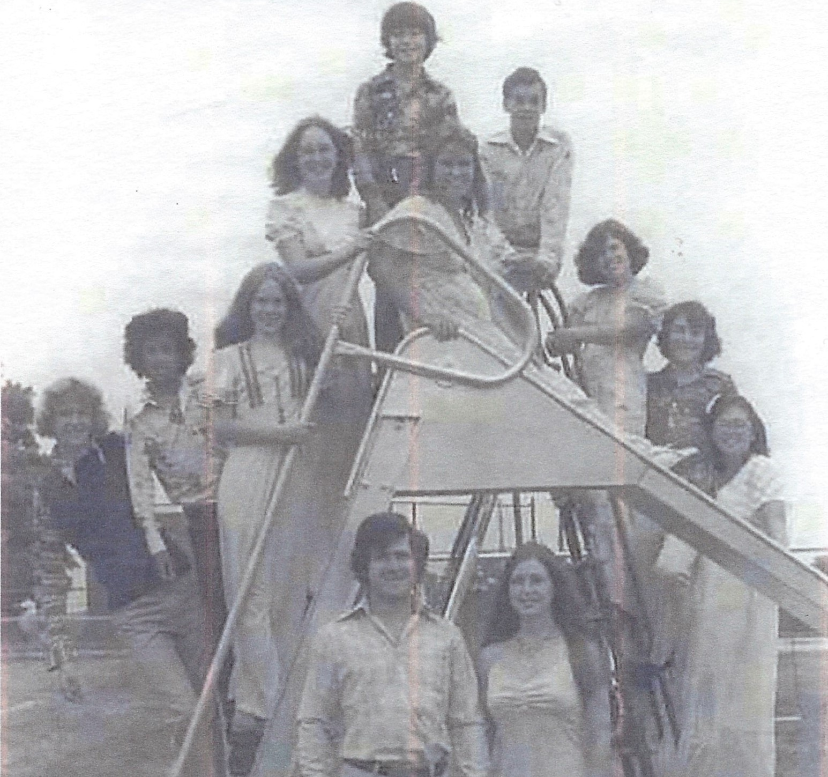
V.F.W. National Home
1975 at the National Home. The Future is here.

Slide 8
National Health & Happiness donations $.10 or $.25 cents per member, paid in full by March 31, 2024 based on June 30, 2023 membership.
Purchase at least one Life Membership from the National Home.
Promote the VFW National Home Help Line 800-313-4200

Slide 9
Utilized VFW National Home materials/Resources on the Department and National website. –Indicate which ones and how.
Promote the V.F.W. National Home thru education in the community.
Attend Michigan Day Aug 6 ! Bring your Banner, American flag. And bring a friend.

Slide 10
Purchase at least one V.F.W. National Home Tribute Brick.

Slide 11
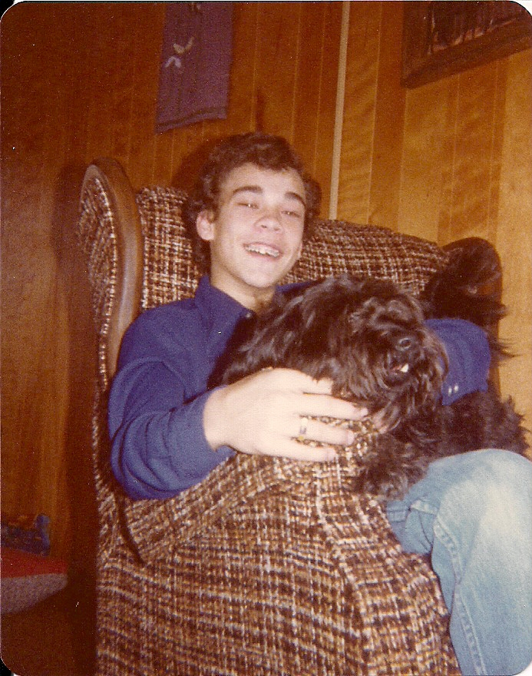
Thank you all for your support in the past.
Thanks for your past support and your continued support as our mission grows.

Slide 12
Me at the National Home.
Can you find me?

Slide 13
Let’s continue our support for the National Home.

